Slide 1
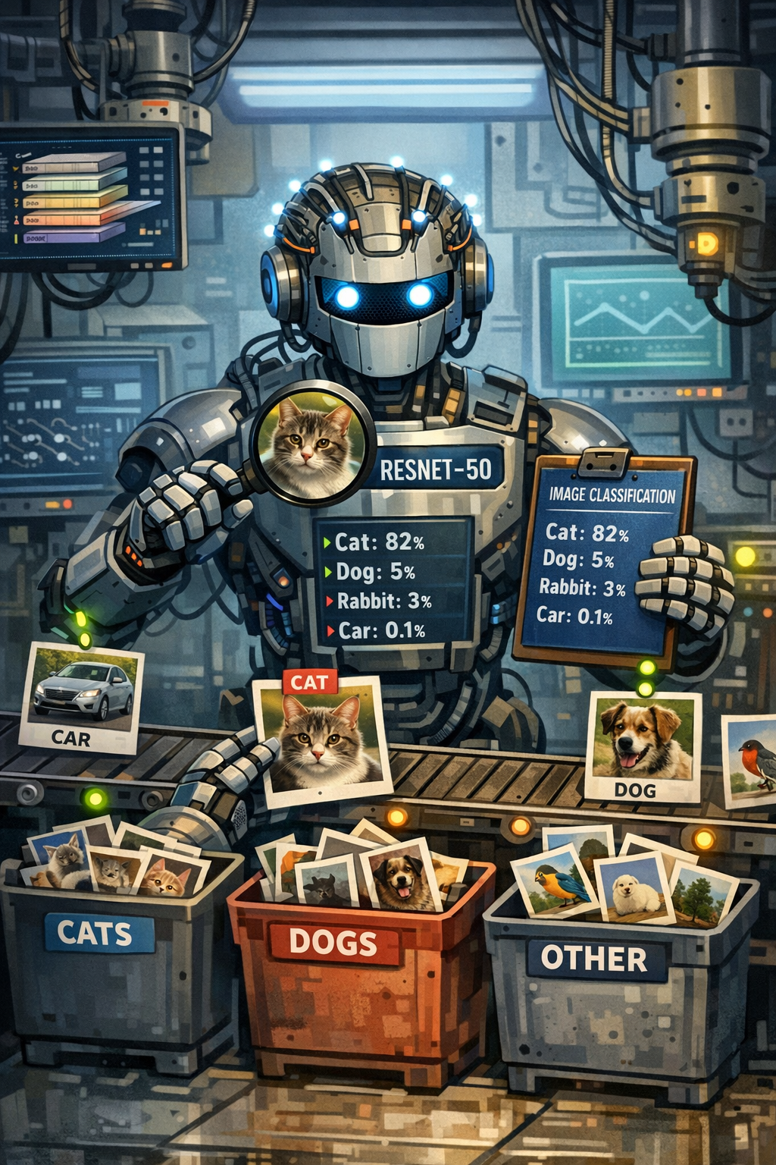
Image Classification with ResNet50
Deep learning exploration using the CIFAR-10 dataset

Slide 2
Content
1. The CIFAR-10 Dataset
2. ResNet50 Architecture
3. Key Challenges with ResNet50
4. Mitigation Strategies
5. Best Model Performance
6. Next Steps & Challenges

Slide 3
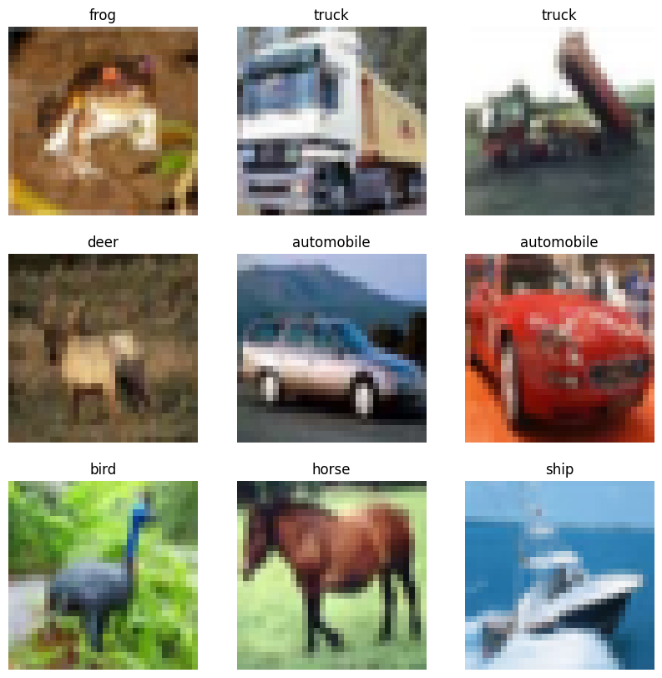
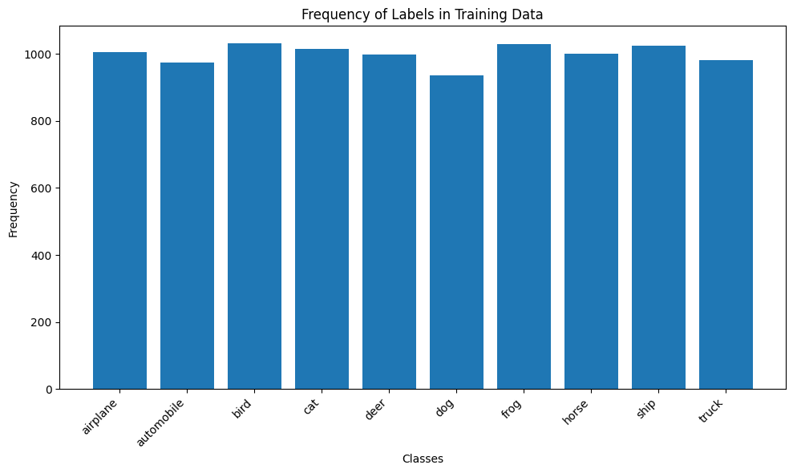
1. The CIFAR-10 Dataset
60 000 color images across 10 classes
32 x 32 pixel resolution
6 000 images per category
Training: 10K | Testing: 10K

Slide 4
2. ResNet50 Architecture
Macro Architecture
Convolution and max pooling
Residual Blocks
Global Average Pooling
Technical Specs
Input Resolution: 224x224x3
Parameteres: 25.6 Million
GFLOPS: 3.8
Bottleneck Blocks
Convolution and max pooling
Residual Blocks
Global Average Pooling

Slide 5
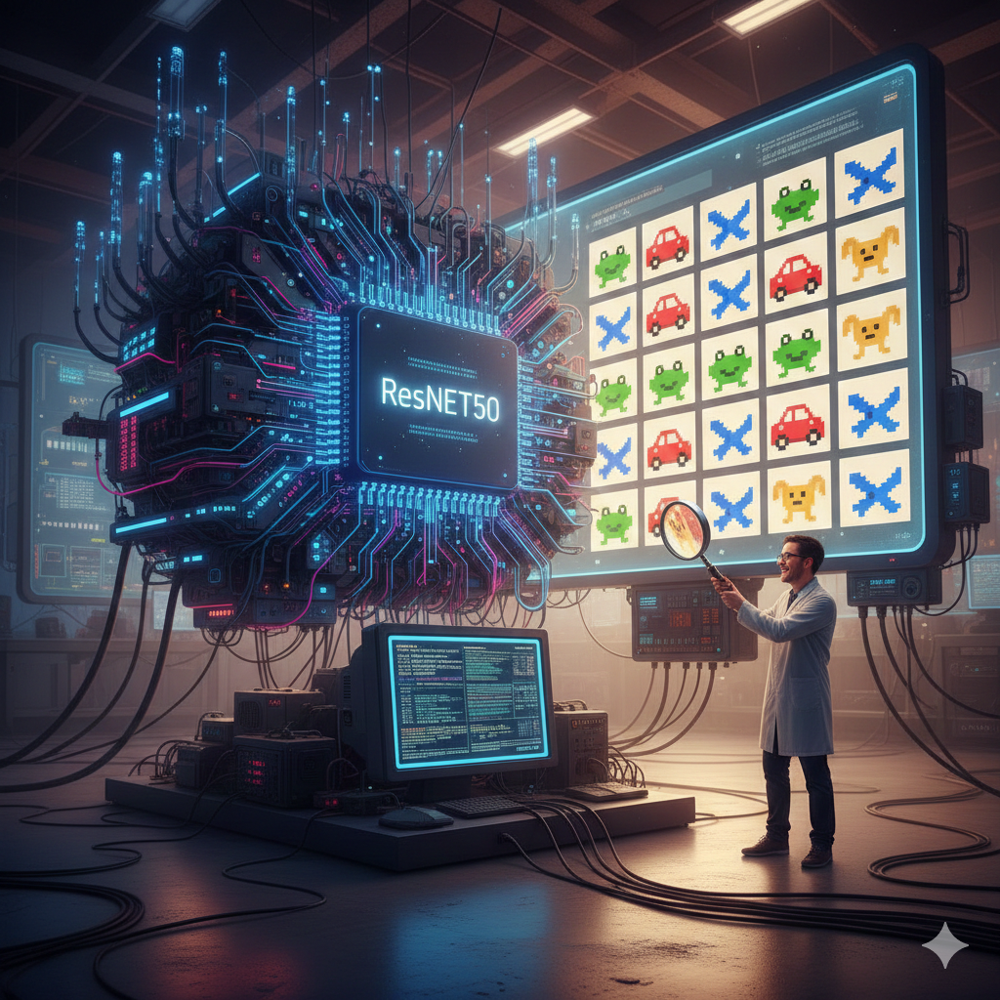
3. Key Challenges with ResNet50
Overfitting
Model capacity exceeds dataset complexity
Limited training examples
Resolution Mismatch
CIFAR-10’s 32x32 vs. ImageNet’s 224x224 pixels
Feature maps collapse too quickly

Slide 6
4. Mitigation Strategies
Overfitting Solutions
Convergence Enhancement
#
#
Dropout Layers
Deactivation of neurons
Prevent co-adaption
Upscaling
32x32 to 224x224
Matching ResNet50’s expected solution
Augmentation
Expand training set
Rotation, flipping, cropping, color jittering
Learning Rate Tuning
CIFAR-10’s 32x32 vs. ImageNet’s 224x224 pixels
Feature maps collapse too

Slide 7



5. Best Model Performance
Accuracy: 86.82 %
Loss: 0.47
2x Dropout 0.25 | 3x Dense | Global Average Pooling 2D
Input: 224x224
Augmentation: Random Flip | Rotation | Brightness | Contrast

Slide 8

6. Next Steps & Challenges
Next Steps
Iterative refinement of:
Hyperparameter exploration
Preprocessing exploration
Challenges
Time intensive training
Many options to refine
Dependencies in preprocessing

